Slide 1
MAITRI: AN AI ASSISTANT FOR PSYCHOLOGICAL & PHYSICAL WELL-BEING OF ASTRONAUTS
CSE7302- University Project
Review-1
Batch Number: CSE_65
Under the Supervision of,
Dr. Balakrishnan Raju
Associate Professor
School of Computer Science and Engineering
Presidency University
Roll Number | Student Name
20221CSE0484 | K SAI SRI
20221CSE0446 | MEGHANA K
Name of the Program: B.Tech, Computer Science and Engineering
Name of the HoD: Dr. Blessed Prince
Name of the Program Project Coordinator: DR. MUTHURAJU V
Name of the School Project Coordinators: Dr. Sampath A K , Dr. Geetha A

Slide 2
Content
Problem Statement
Objectives
Background and Related work for title Selection
Analysis of Problem Statement
Innovation or Novel Contributions
Timeline of the Project
References

Slide 3
Problem Statement
Problem Statement Number: SIH25175
Organization: Indian Space Research Organisation(ISRO)
Category: Software
Problem Description: MAITRI: An AI Assistant for Psychological & Physical Well-Being of Astronauts
Long-duration space missions expose astronauts to stress, isolation, and fatigue, while delayed communication with Earth limits continuous support, creating the need for an autonomous AI-based well-being assistance system.

Slide 4
Objectives
To develop an AI-powered assistant that supports the psychological and physical well-being of astronauts during long-duration space missions.
To provide a conversational interaction mechanism that allows astronauts to naturally express stress, fatigue, and daily experiences, and to analyze these interactions to detect emotional and stress levels.
To monitor overall well-being trends by integrating emotional indicators with simulated physical parameters such as sleep quality and fatigue levels.
To generate a well-being risk score and adaptive support strategies, including relaxation activities and routine guidance, for early identification and mitigation of mental or physical strain.
To design and evaluate a privacy-aware, offline-capable web-based system, including a dashboard for visualizing well-being status, trends, and recommendations using simulated mission scenarios.

Slide 5
Background and Related work
AUTHOR | YEAR | TITLE | METHODOLOGY | INFERENCE
Annahita Nezami | 2025 | Space Psychology: A Comprehensive Approach to the Future of Astronaut Well-Being | Review and analytical method based on existing research, theories, and literature | A combined approach of psychology and technology is essential for future space missions
Sardar Ali Shah, Saba Karim, Ramesh Kumar, Amir Latif Bhatti | 2024 | Beyond the Gravity: Exploring Legal Position of Astronauts’ Well-Being in Space | Doctrinal research method analyzing space laws, international treaties, and regulations | Existing space laws need improvement to better protect astronauts
Ivan A. Rozanov | 2022 | Psychological Support for Astronauts in Space | Use of Virtual Reality (VR); data collected through observations, questionnaires, and sleep monitoring | Psychological support methods can be extended to hospitals and general medical care
Francesco Pagnini, Francesca Grosso | 2025 | Human Space Exploration: Benefits to Humanity | Analysis of existing research studies and space psychology literature | Astronauts experience stress and mental health challenges during long-duration missions
Yi Wang, Delong Dong, Wenlian Zhou | 2025 | Wearable Health Monitoring for Astronauts | Study of current wearable technologies and flexible wearable device applications in space | Wearable devices enhance astronaut safety, though technical challenges still remain

Slide 6
Background and Related work(contd...)
AUTHOR | YEAR | TITLE | METHODOLOGY | INFERENCE
Nathan Smith | 2023 | Technology to Support Mental Health in Deep Space | Analysis of digital health technologies combined with psychological and human-factor theories | Digital tools such as VR, AI assistants, monitoring systems, and automated support can effectively aid astronaut mental health
Antonia Russo, Gianluca Lax | 2022 | Using Artificial Intelligence for Space Challenges | Application of Machine Learning, Deep Learning, Reinforcement Learning, and NLP | Provides strong justification for systems like MAITRI that integrate mental health monitoring with decision support
Mario A. Cypko, Ulrich Straube, Russell J. Andrews, Oliver Amft | 2025 | Digital Health for Space: Towards Prevention, Training, Empowerment, and Autonomy | Evaluation across space mission scenarios (ISS, Moon, Mars, deep space) | Long-duration space missions require autonomous digital health systems
Brenda K. Wiederhold | 2025 | From Cyberspace to Outer Space | Discussion of existing and emerging digital technologies | Astronauts face significant mental health challenges due to isolation, stress, and extended missions
Donald D. Chang | 2020 | Promoting Tech Transfer Between Space and Global Mental Health | Space medicine research using a systematic review method | AI, mobile apps, sensors, telemedicine, and chatbots can effectively support mental health care

Slide 7
Analysis of Problem Statement
Astronauts who stay in space for a long time face mental and physical challenges due to isolation, confinement, and heavy work pressure.
Problems such as stress, tiredness, poor sleep, and reduced concentration usually develop slowly and are hard to notice in the early stages.
At present, astronauts mainly depend on scheduled communication with Earth and basic health monitoring for support.
In deep space missions, communication delays make it difficult to receive continuous psychological support from Earth.
Existing systems focus mostly on physical health or mission tasks and do not provide continuous emotional or mental well-being support.
Hence, there is a need for an AI-based system that can continuously monitor well-being, identify early warning signs, and provide supportive guidance during long-duration space missions.

Slide 8
Innovation or Novel Contributions
Our system is unique because it:
Brings psychological and physical well-being support into one platform – conversation, stress understanding, risk monitoring, and guidance are all combined in a single system.
Allows astronauts to express their feelings naturally – through a simple chat interface without pressure or judgement.
Understands stress and emotional patterns over time – instead of reacting to a single message, it tracks changes across days.
Provides personalized and adaptive support – suggestions and responses change based on the astronaut’s condition and past interactions.
Identifies early warning signs – a well-being risk score helps detect mental or physical strain before it becomes serious.
Works in low-connectivity or offline environments – ensuring continuous support even when communication with Earth is delayed.
Respects privacy and ethical boundaries – offers support without medical diagnosis or sharing personal data.

Slide 9
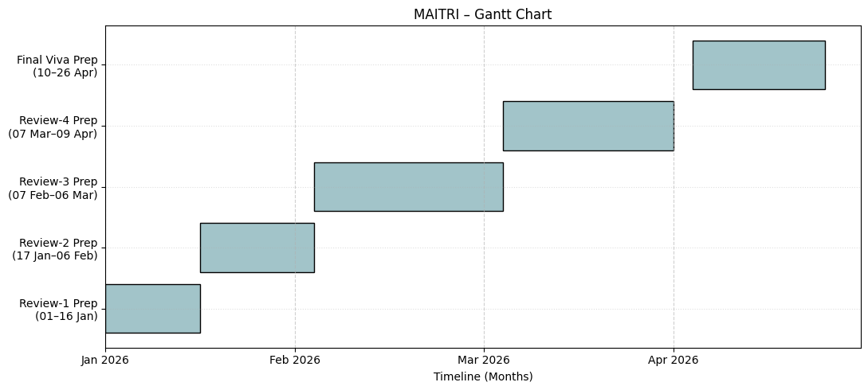
Timeline of the Project (Gantt Chart)

Slide 10
References (IEEE Paper format)
[1] D. D. Chang, E. A. Storch, L. Black, M. Berk, N. Pellis, H. Lavretsky, J. Sutton, K. Ternes, M. Shepanek, E. Smith, R. Abbott, and H. A. Eyre, “Promoting tech transfer between space and global mental health,” Aerospace Medicine and Human Performance, vol. 91, no. 9, pp. 737–745, Sep. 2020.
[2] S. L. Chandra, P. R. Nair, and R. Kumar, “Artificial intelligence–based mental health support systems: A review,” arXiv preprint arXiv:2105.03216, May 2021.
[3] J. R. Clément and R. S. Ngo-Anh, “Keeping astronauts healthy during long-duration space missions,” Acta Astronautica, vol. 126, pp. 168–176, Sep. 2016.
[4] M. A. Cypko, U. Straube, R. J. Andrews, and O. Amft, “Digital health for space: Towards prevention, training, empowerment, and autonomy,” in Advancing Human-Computer Interaction for Space Exploration (SpaceCHI), 2025.
[5] L. A. De La Torre, A. L. Jennings, and R. J. Harvey, “Psychological challenges of long-duration spaceflight,” Journal of Applied Physiology, vol. 120, no. 7, pp. 1–9, 2016.
[6] European Space Agency (ESA), “Behavioral health and performance research for long-duration space missions,” ESA Human and Robotic Exploration Directorate, 2022.
[7] M. A. R. Finlayson, K. McNeal, and L. A. D’Mello, “Emotional detection and monitoring using conversational agents,” IEEE Transactions on Affective Computing, vol. 11, no. 2, pp. 1–14, 2020.
[8] F. Pagnini and F. Grosso, “Human space exploration: Benefits to humanity,” 2025.
[9] I. A. Rozanov, “Psychological support for astronauts in space,” 2022.
[10] K. Sandal, G. R. Leon, and S. Palinkas, “Human challenges in polar and space environments,” Reviews in Environmental Science and Bio/Technology, vol. 5, no. 2–3, pp. 281–296, 2006.

Slide 11
References (IEEE Paper format)(contd...)
[11] T. B. Sheridan, “Human–AI interaction and trust in autonomous systems,” Human Factors, vol. 63, no. 5, pp. 1–12, 2021.
[12] N. Smith, “Technology to support mental health in deep space,” 2023.
[13] B. K. Wiederhold, “From cyberspace to outer space,” Cyberpsychology, Behavior, and Social Networking, 2025.
[14] Y. Wang, D. Dong, and W. Zhou, “Wearable health monitoring for astronauts,” 2025.
[15] G. G. De la Torre, “Behavioral health research in space analog,” 2024.
[16] N. J. Kanas, V. Salnitskiy, E. Grund, et al., “Interpersonal and cultural issues involving crews and ground personnel during International Space Station missions,” Aviation, Space, and Environmental Medicine, vol. 80, no. 7, pp. 647–655, Jul. 2009.
[17] A. A. Kanas and D. Manzey, Space Psychology and Psychiatry, 2nd ed., Springer, Dordrecht, 2008.
[18] A. Nezami, “Space psychology: A comprehensive approach to the future of astronaut wellbeing,” Frontiers in Virtual Reality, Jan. 2025.
[19] S. A. Shah, S. Karim, R. Kumar, and A. L. Bhatti, “Beyond the gravity: Exploring legal position of astronauts’ well-being in space,” 2024.
[20] S. Hussain, Z. Wang, and S. Rahim, “Ethical and privacy challenges in AI-driven health support systems,” arXiv preprint arXiv:2303.04127, Mar. 2023.

Slide 12


